Slide 1
A
Project Report on
Analysis, Design and Implementation
Of
Database for Nursery Store
Presenters:
Rabin Khadka (23)
Rachit Basnet (24)
Rajendra Karki (25)
Ram Krishna Pudasaini (26)

Slide 2
INTRODUCTION
A nursery database is a structured collection of information related to nursery and its operation and management. . It is useful tool for organizing, storing, and retrieving value related to nursery.A nursery database is a powerful tool that supports the efficient management of a plant nursery.
A nursery database consist of dataset related plant,order id ,order,,order item,plant,plant categories,customers and categories.

Slide 3
PROBLEM STATEMENT
Despite of many benefits of Nursery dataset, it has many challenges in order to prepare dataset.
The following problem statement highlights some common concerns.
Limited Plant Information
Supplier Management Challenges
Poor Customer Service
Inefficient Data Management
The nursery requires a robust and user-friendly database system that can handle the complexity of plant management, customer records, and sales tracking.
Notes:
Limited Plant Information,supplier Management Challenges,Poor Customer Service,Inefficient Data Management.The existing manual processes and scattered data make it difficult to keep track of plant varieties, customer preferences, stock levels, and purchase history.This results in inefficiencies, inaccuracies, and a lack of real-time insights for decision-making.
The nursery requires a robust and user-friendly database system that can handle the complexity of plant management, customer records, and sales tracking. The system should enable easy data entry, retrieval, and updating of information, while providing accurate and up-to-date reports and analytics. Additionally, it should support functionalities like plant categorization, tracking plant growth stages, managing supplier information, and generating invoices and receipts.

Slide 4
OBJECTIVES
Data Organization: The nursery dataset aims to organize and maintain a comprehensive collection of information related to plants, customers, inventory, and sales in a structured and easily accessible manner.
Efficient Inventory Management: The dataset seeks to facilitate efficient management of plant inventory by accurately tracking the available stock, plant varieties, growth stages, and supplier information. This enables the nursery to optimize its purchasing, pricing, and restocking processes.
Customer Relationship Management: The dataset aims to enhance customer relationship management by storing and analyzing customer information, preferences, purchase history, and communication records. This allows the nursery to provide personalized services, track customer interactions, and foster long-term relationships.

Slide 5
OBJECTIVES
Sales Tracking and Analysis: The dataset aims to enable accurate tracking and analysis of sales data, including the quantity and value of plants sold, pricing trends, popular plant varieties, and seasonal demand patterns. This information helps the nursery make informed decisions about pricing, promotions, and sales strategies.
Reporting and Analytics: The dataset aims to generate insightful reports and analytics, providing the nursery with valuable information on key performance indicators, sales trends, customer behavior, and inventory metrics. These insights enable data-driven decision-making and strategic planning.
Scalability and Adaptability: The dataset aims to be designed to accommodate future growth and adapt to evolving business needs. It is scalable, allowing the addition of new plant varieties, customers, and inventory items. It will also be flexible, enabling customization and integration with other systems or technologies as required.

Slide 6
ANALYSIS
The analysis of the Nursery Store database design involves evaluating its key components, structure, and functionality. Here is an overview of the analysis:
Database Components:
Tables: The database design should include tables to store essential data entities such as inventory, sales, customers, suppliers, and reports.
Relationships: The relationships between tables should be properly defined, such as one-to-many relationships between sales and customers or suppliers, and foreign key constraints to ensure data integrity.
Primary Keys: Each table should have a primary key to uniquely identify records and facilitate efficient data retrieval.

Slide 7
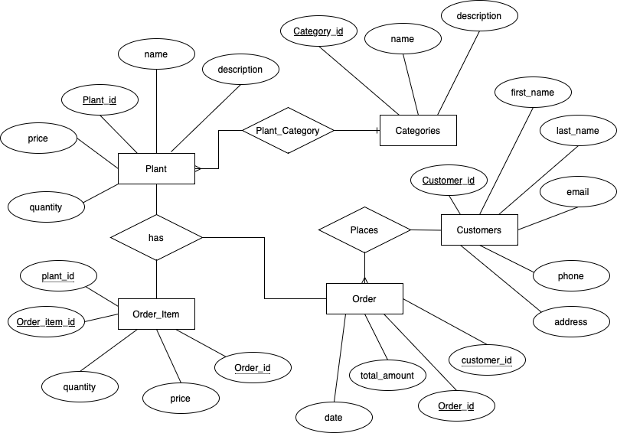
ER
DIAGRAM

Slide 8
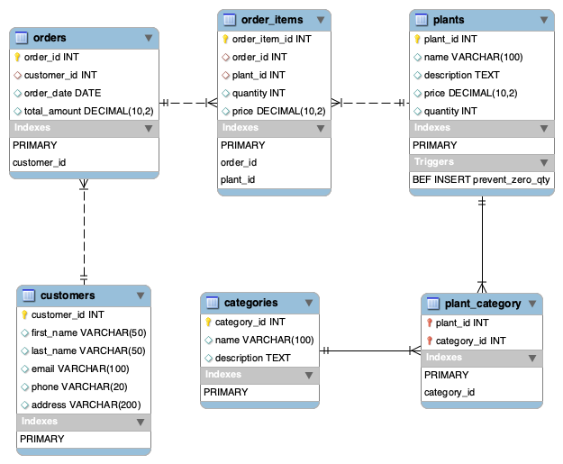
SCHEMA DESIGN

Slide 9
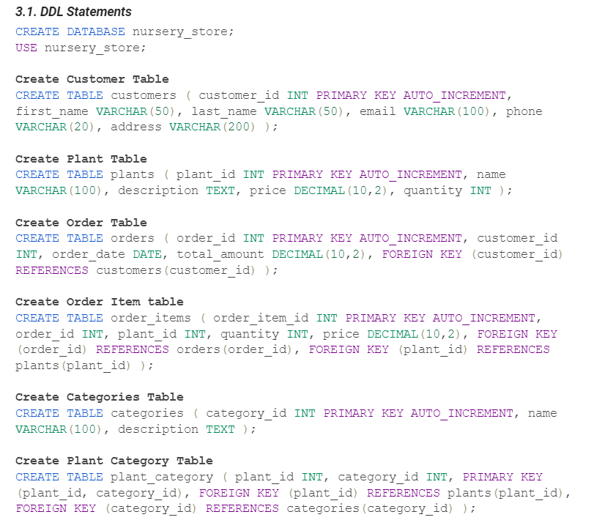
DDL
STATEMENTS

Slide 10
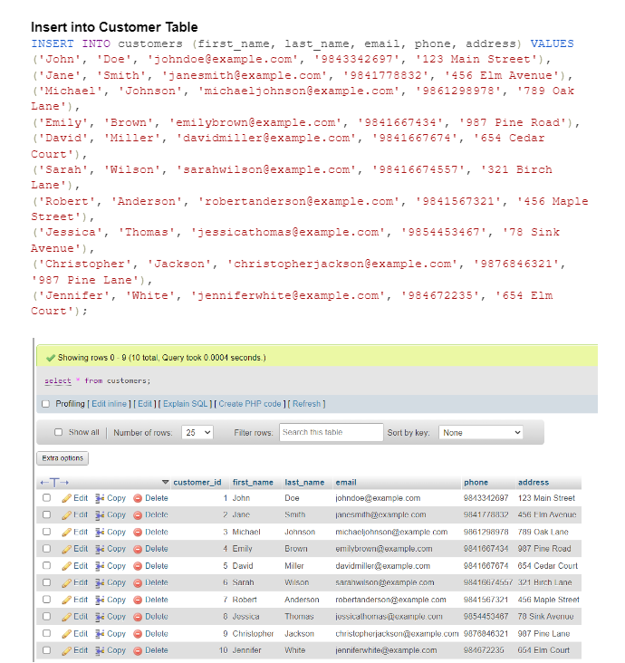
DML
STATEMENT
Insert

Slide 11
DELIMITER //
CREATE PROCEDURE CalculateTotalOrderAmount(IN orderDate DATE, OUT totalAmount DECIMAL(10,2))
BEGIN
SELECT SUM(total_amount) INTO totalAmount
FROM orders
WHERE order_date >= orderDate;
END //
DELIMITER ;
CREATE PROCEDURE CalculateTotalOrderAmount(IN orderDate DATE, OUT totalAmount DECIMAL(10,2)) BEGIN SELECT SUM(total_amount) INTO totalAmount FROM orders WHERE order_date >= orderDate; END;
Call the Stored Procedure
CALL CalculateTotalOrderAmount('2023-06-01', @total);
SELECT @total AS total_amount;
Store Procedure

Slide 12
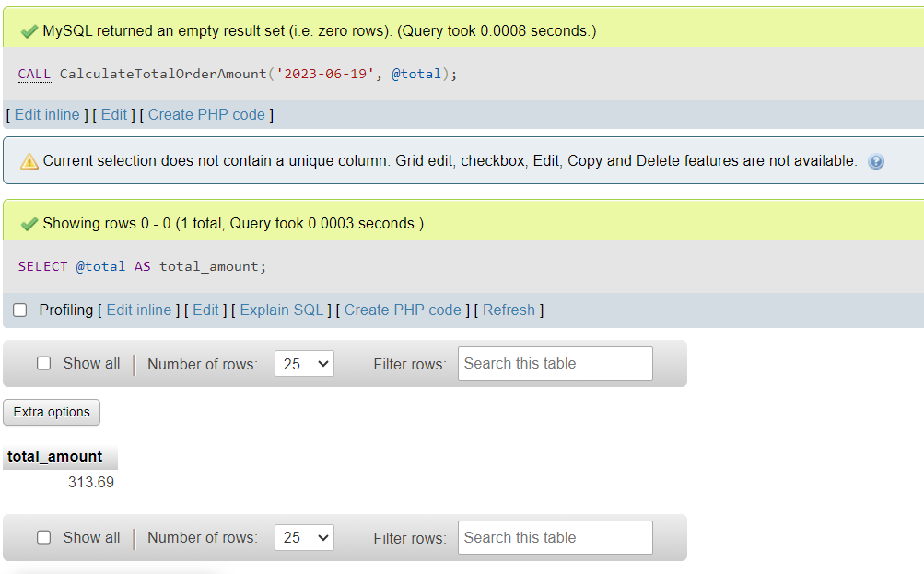
Store Procedure

Slide 13
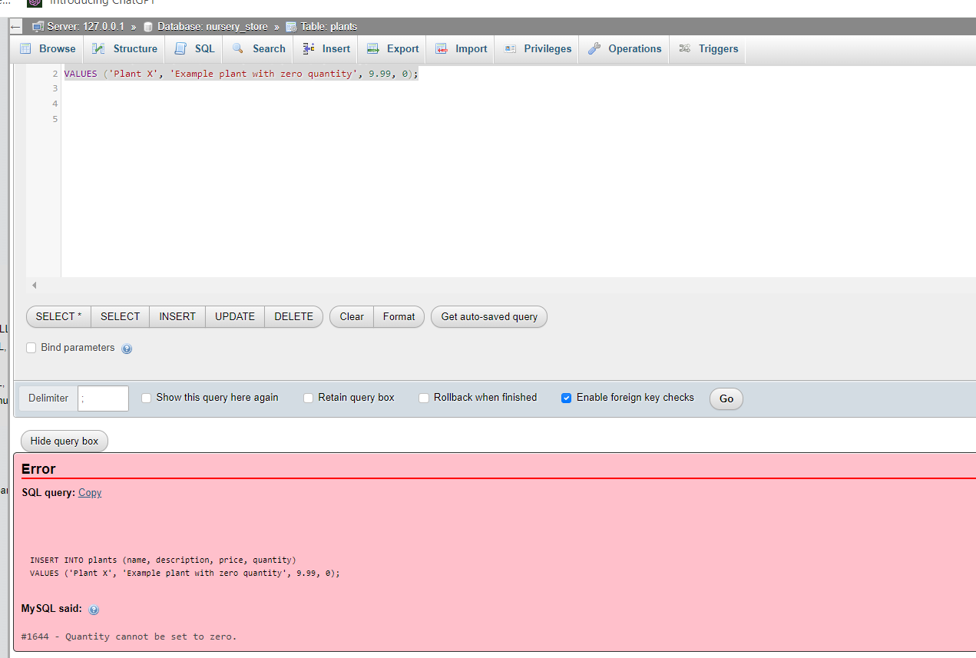
DELIMITER //
CREATE TRIGGER prevent_zero_qty
BEFORE INSERT ON plants
FOR EACH ROW
BEGIN
IF NEW.quantity = 0 THEN
SIGNAL SQLSTATE '45000'
SET MESSAGE_TEXT = 'Quantity cannot be set to zero.';
END IF;
END //
DELIMITER ;
TRIGGERS

Slide 14
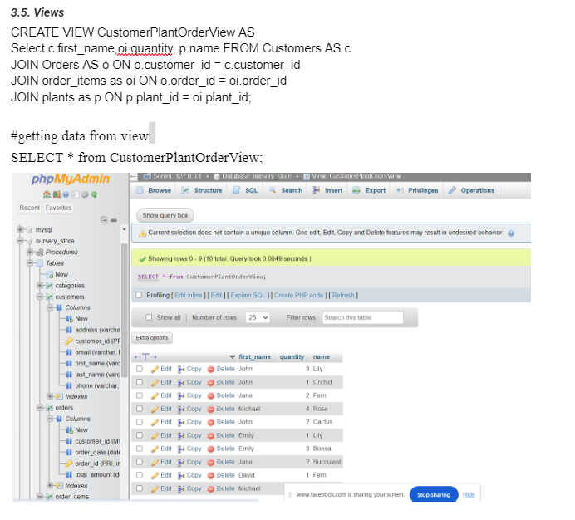
CREATE VIEW CustomerPlantOrderView AS
Select c.first_name,oi.quantity, p.name FROM Customers AS c
JOIN Orders AS o ON o.customer_id = c.customer_id
JOIN order_items as oi ON o.order_id = oi.order_id
JOIN plants as p ON p.plant_id = oi.plant_id;
# Using View
SELECT * from CustomerPlantOrderView;
Views

Slide 15
Conclusion
We have successfully implemented Nursery Management using nursery data store.

